Slide 1
Offline Analysis Of Document Using LLM Conversational Flow
Supervisor: Sir Farhan Mehmood

Slide 2




Group Members
Faiza Iftikhar
Eman Tahir
Shumail Inam
200901043
200901059
200901032
4

Slide 3



Table of Contents
Objectives
01
05
Results
02
06
Tech Stack
Future Work
Flow Diagram
03
07
Gantt Chart
Fyp deliverables/ discussions
04
08
Live Demo

Slide 4
OBJECTIVES
01
02
03
To Develop a applied offline-desktop and web application
To Support Diverse Document Formats
To Enhance Document Analysis and generate response
04
05
06
To add feature multiple documents
To Train sentiment analysis model
To Integrate sentiment analysis model on user query

Slide 5
OBJECTIVES
06
07
08
To scrap ist website
To develop ist chatbot
To integrate ist chatbot
09
10
11
To develop sqlite database
To implement feature toggle mode
To implement feature save messages or not
12
To implement feature relative time

Slide 6





TECH STACK
Frontend Development:
Collaboration & Project Management:
UI/UX Design: Figma
Frontend: React
JIRA
Teams
GitHub
Google Meet
Database & Backend Development:
Backend: TypeScript, python
Database: Chroma & SQLite
Deployment:
Docker
Framework & LLM:
Framework: Langchain, FastApi
LLM: All-minilm, Gemma2, Bert

Slide 7
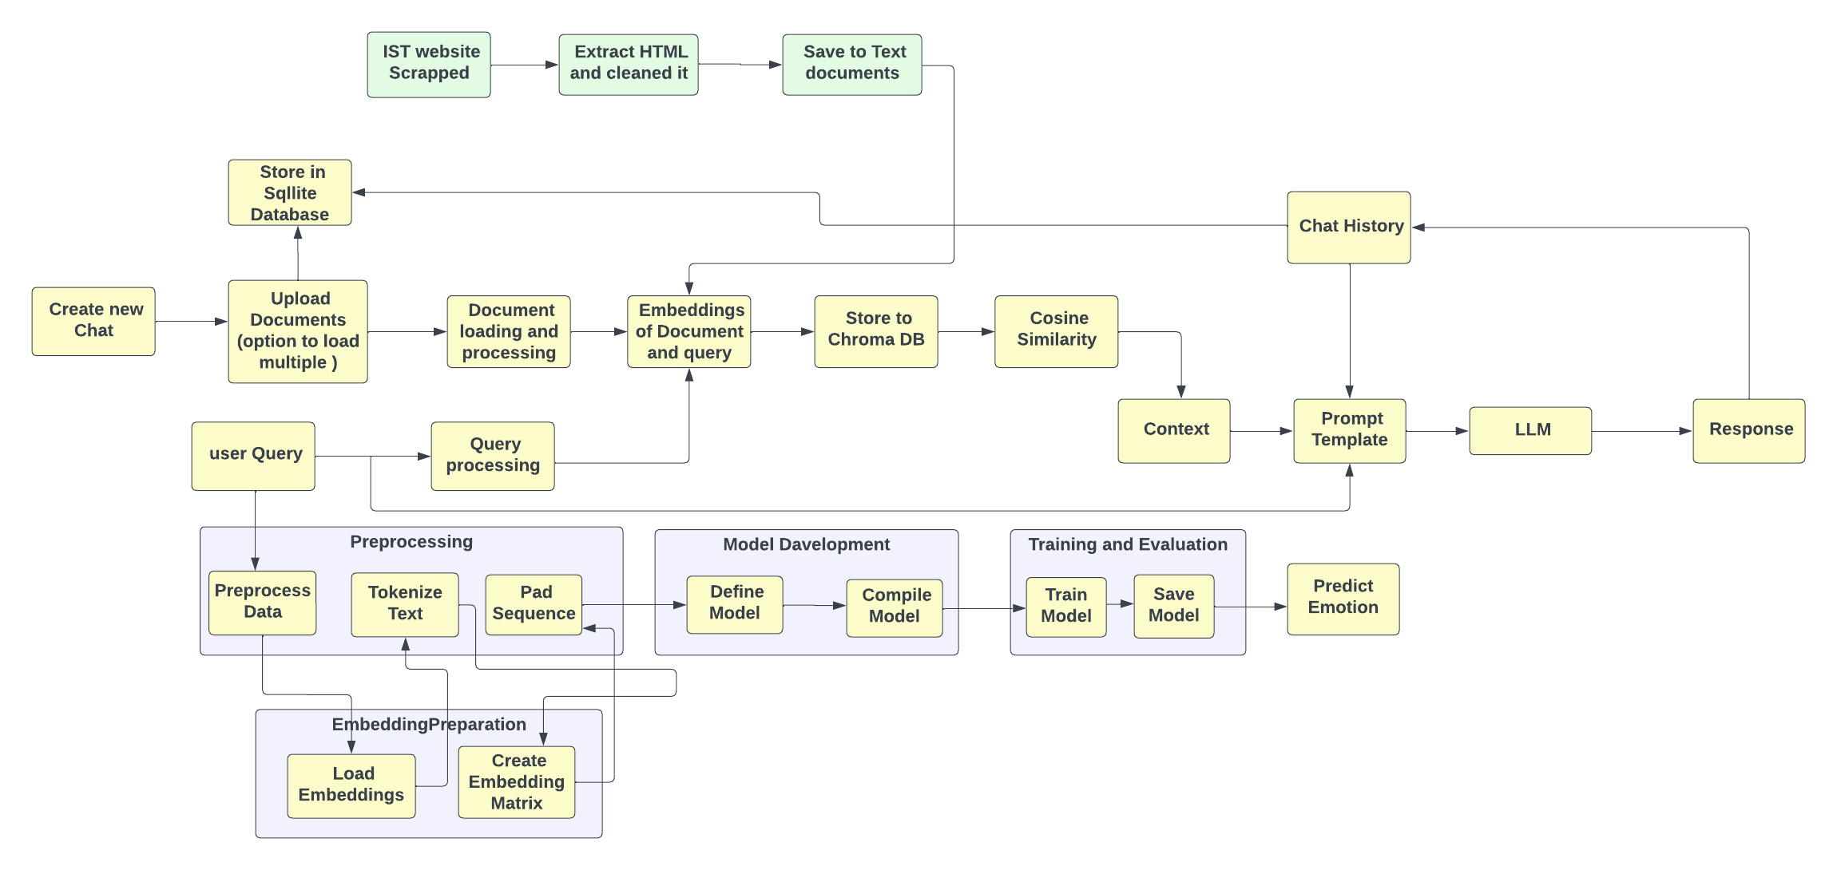
Flow Diagram of project:
6

Slide 8
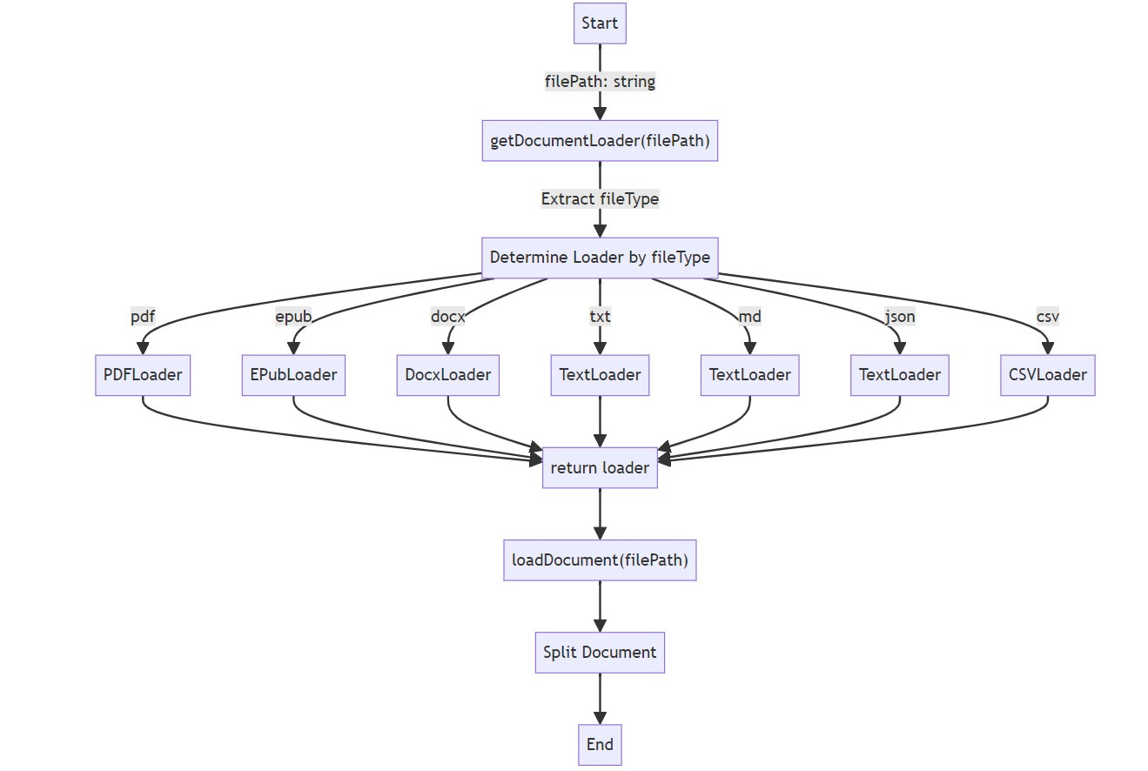
Document Loading and Processing
6

Slide 9
Document Loading and Processing
Document Type Supporter
filePath.split('.').pop()
Accepts various document
formats: PDF, EPUB, DOCX, TXT, MD, CSV.
filePath.split('.'): Splits the filePath string into an array using the dot (.) as a delimiter. This assumes the file extension is at the end of the path.
.pop(): Retrieves the last element of the array, which is assumed to be the file extension.
Document Loader Selection
Determines the document type based on file extension filePath.split('.').pop()
to select the appropriate loader.
6

Slide 10
Document Loading and Processing
Loader Types:
Flexibility and Handling:
Specific loaders for each document type:
PDFLoader, EPubLoader, textLoader, DocxLoader, CsvLoader
Modular approach allows handling of different document types seamlessly.
Provides customization options like split settings for specific loaders (e.g., splitPages for PDFLoader, splitChapters for EPubLoader).
Loading and Splitting
Then after loading and splitting the document
6

Slide 11
Embedding of Document and Query
Introduction to Embedding
Purpose: Transforming textual data into numerical representations for machine processing
Importance: Enables understanding of semantic relationships between words and phrases
Embeddings in AI: Embeddings are numerical representations of real-world objects that machine learning (ML) and artificial intelligence (AI) systems use to understand complex knowledge domains like humans do.
6

Slide 12
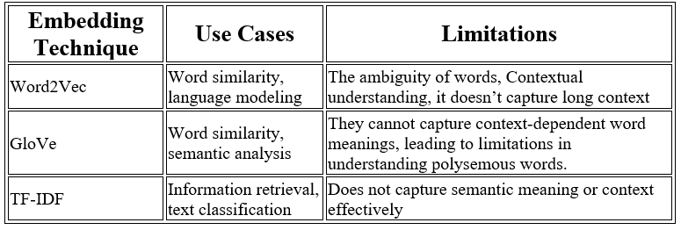
Embedding of Document and Query
CAMPARISON OF MODELS FOR EMBEDDINS
6

Slide 13
Embedding of Document and Query
Introduction to LLMs
Definition: Advanced models designed to capture deep contextual and semantic relationships.
Examples: Meta Llama 3, Alibaba's Qwen2 Series, Microsoft's Phi-3 Family, Cohere's Aya 23, Mistral AI's 7B Model, gemma2, all-minimum
Advantages: Superior performance in understanding and generating complex language patterns.
6

Slide 14
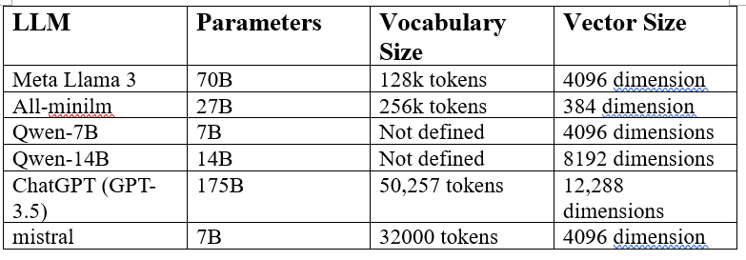
Embedding of Document and Query
CAMPARISON OF LLMs FOR EMBEDDINS
6

Slide 15
Embedding of Document and Query
SELECTION OF LLM
Choice of Embedding Model: All-minilm selected for embeddings due to effective system compatibility and response speed.
Performance Considerations: Heavier embedding models lead to impractically long response times.
Accuracy vs. Efficiency: While heavier models offer higher accuracy, they exceed system capabilities.
Optimal Balance: Gemma2 strikes the right balance between performance and efficiency for our application needs.
6

Slide 16
Embedding of Document and Query
Locally run LLM
Setup of Ollama for to Locally run LLM.
Integration of LLM
Integarting LLM through LangChain
6

Slide 17
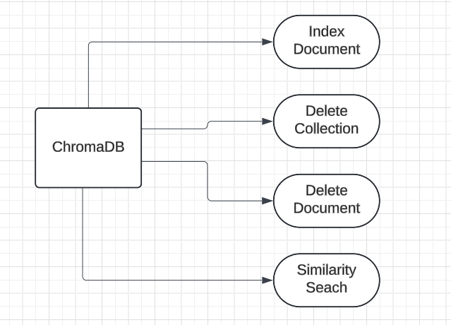
Vector Database (ChromaDB)
6

Slide 18
Vector Database (ChromaDB)
Index Document
Indexes a batch of documents (docs) into ChromaDB.
DeleteCollection
Deletes an entire collection from ChromaDB.
DeleteDocument
Deletes specific collection.
similaritySearch
Performs a similarity search (cosine similarity) using the provided text against
documents in a specified collection (collectionName) in ChromaDB.
6

Slide 19
Making Vector Database Api
FastApi
Making vector database api using FastApi
Docker
Deploying the FastApi on docker
6

Slide 20
Generating Context
By applying similarity search between user query and document
Similarity Search
ChromaDb similarity search use cosine similarity
Cosine Similarity
Cosine similarity measures the cosine of the angle between two vectors in a multidimensional space.
Similarity (A,B) = A.B/|A| |B|
6

Slide 21
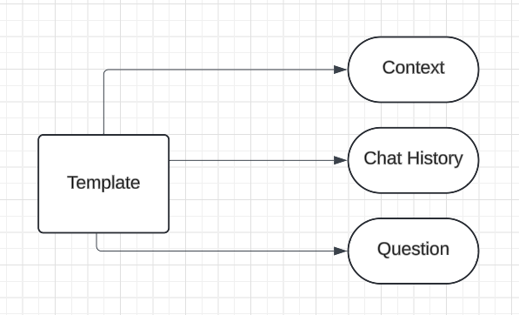
Response Template
Constructs a structured template for the response using markdown format.
Initializes a PromptTemplate instance with the defined markdown template.
Creates an instance of
BytesOutputParser to parse the
output generated by the AI model.
6

Slide 22
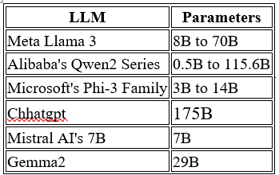
Choosing LLM
CAMPARISON OF LLMs
6

Slide 23
LLM for Response
The LLM we are integrating for response is Gemma2
Chaining operation for Gemma2 responses
Chains together operations using the pipe method to process the template through the Gemma2 model and parse the output.
Streaming the responses (StreamingTextResponses)
Executing the chain of operations
Returns a StreamingTextResponse
6

Slide 24
Sentiment Analysis Model Training
Dataset
comprises a total of 13,191 entries, each associated with a specific emotional label.
Emotional Categories
Joy
Sadness
Anger
Fear
Neutral
The dataset was split into training and testing sets with a ratio of 80% for training and 20% for testing.
The dataset was compiled by integrating two distinct sources obtained from Kaggle
2,000 entries were manually added by analyzing day-to-day conversations with chatbot.

Slide 25
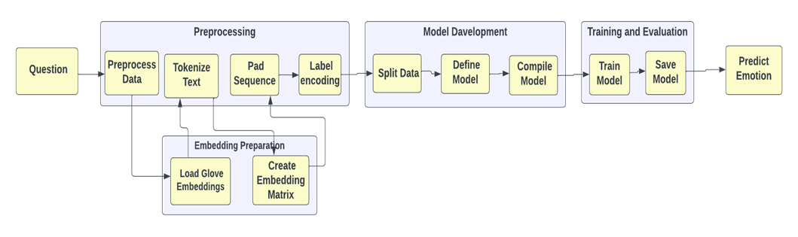
Sentiment Analysis Model Training
Model 1 explanation
Preprocess data
Drops rows with missing values, Removes special characters, converts text to lowercase,
removes stopwords, stemm them
load glove embeddings: load them in dict (word, vector)
Tokenize Text and create embedding matrix

Slide 26
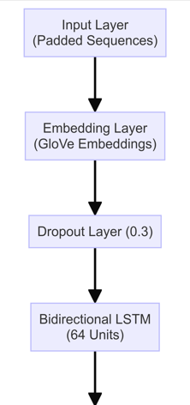
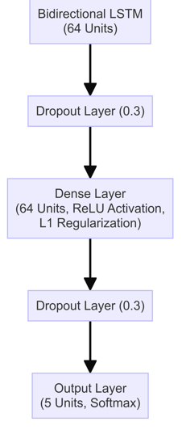
Neural network architecture

Slide 27
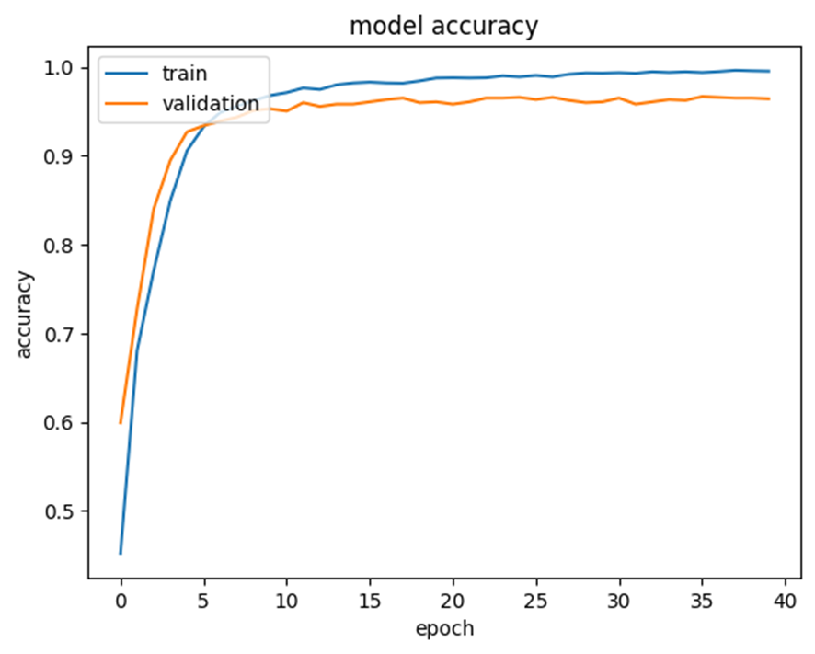
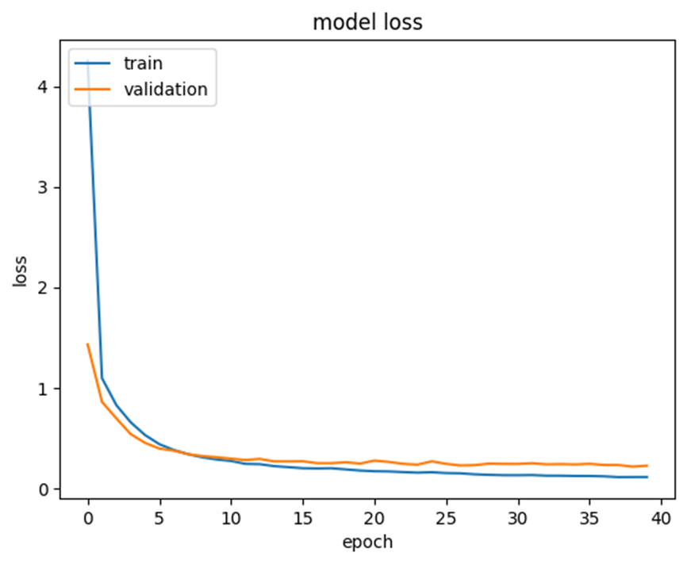
Training and Validation Accuracy and Loss
Training and Validation Alignment
Model Generalization
Early Stabilization

Slide 28
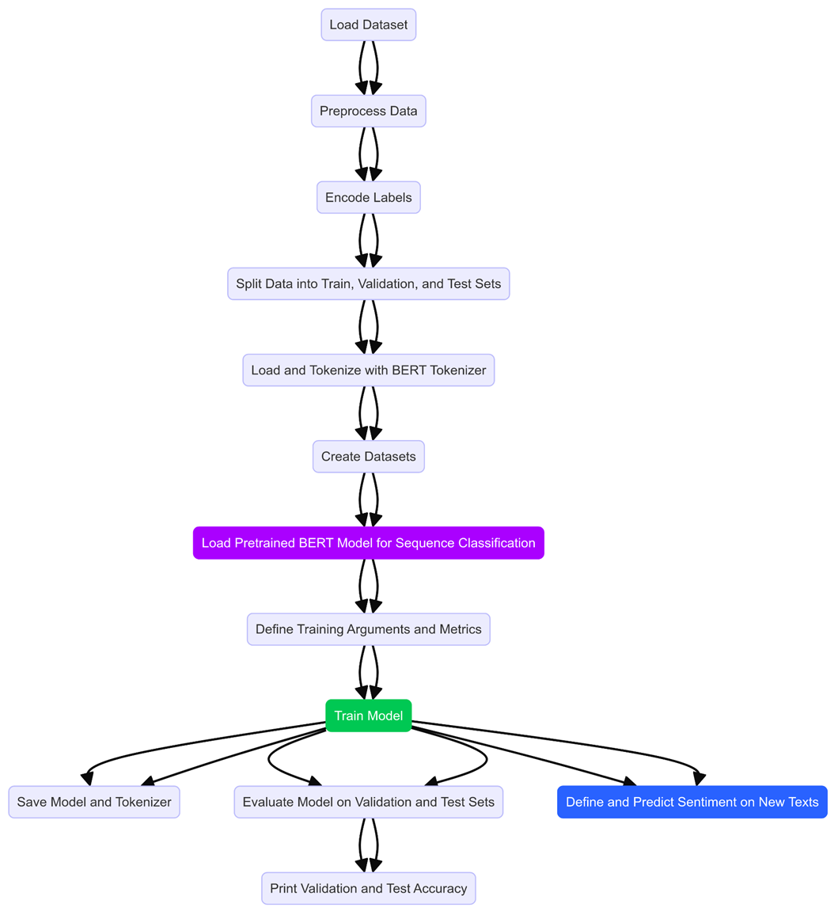
Sentiment Analysis Model Training
Model 2:
1. Load Dataset
2. Preprocess Data
3. Encode Labels
4. Split Data into Train, Validation, and Test Sets
5. Load and Tokenize with BERT Tokenizer
6. Create Datasets
7. Load Pretrained BERT Model for Sequence Classification
8. Define Training Arguments and Metrics
9. Train Model
10. Save Model and Tokenizer
11. Evaluate Model
12. Define and Predict Sentiment

Slide 29
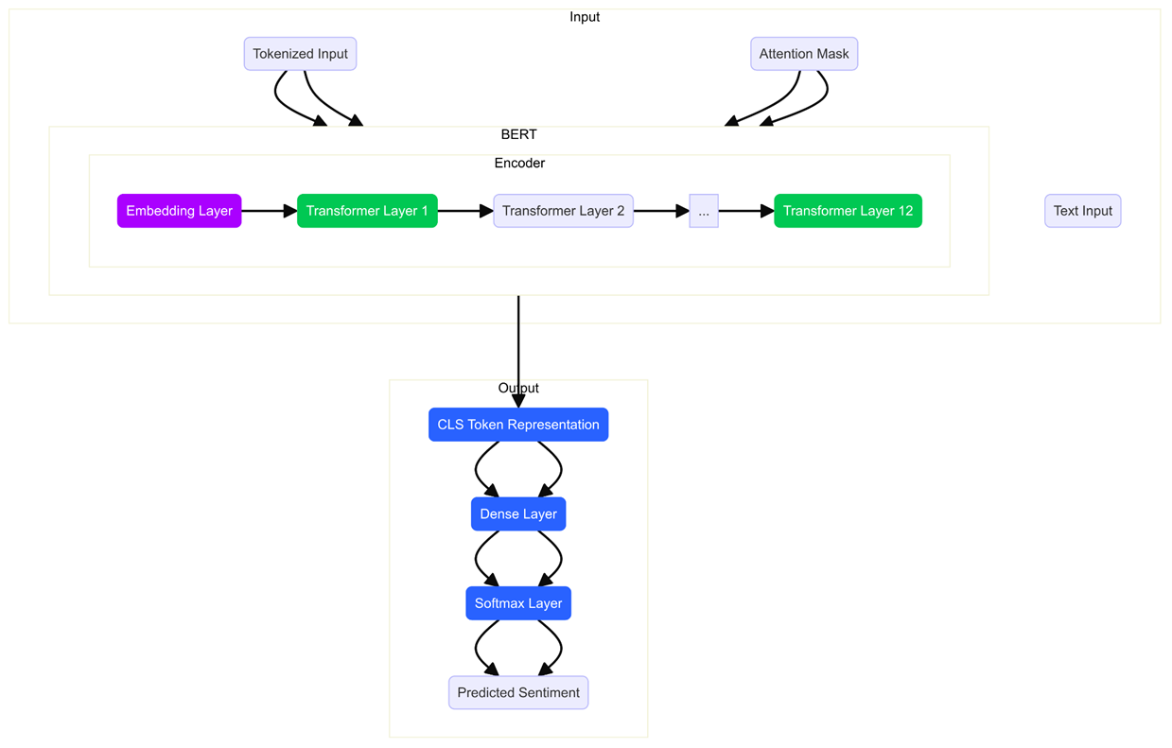
Model 2:
Neural network architecture
Input Layer:
Text Input
Tokenized Input
Attention Mask (Padding,
"[CLS]", "I", "love", "NLP", "[SEP]", 0, 0)
Bert Encoder
Embedding Layer
Transformer Layers
Output Layer
CLS Token Representation: [CLS] token is used as the aggregate representation of the entire input sequence.
Dense Layer: transform the high-dimensional embedding
into a format suitable for the final classification (produce the class scores.)
Softmax Layer: scores into probabilities for each sentiment.

Slide 30
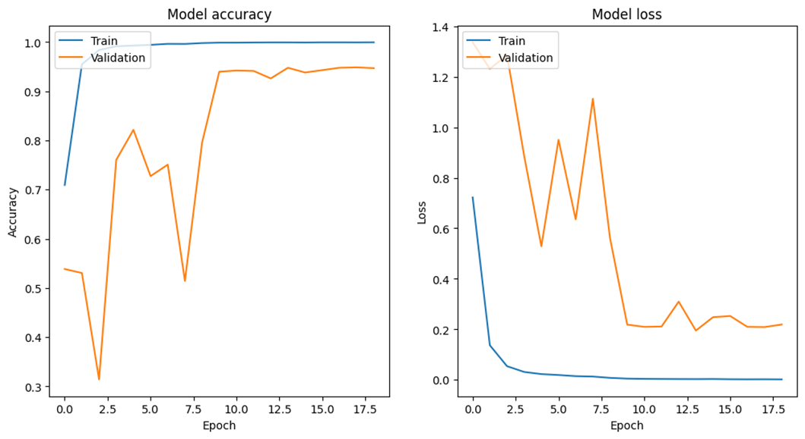
Training and Validation Accuracy and Loss
model is not overfitting
generalize well
good learning

Slide 31
Feature | Model 1 | Model 2 | Model 3
Embedding | Trained Embeddings (128 dimensions) | GloVe Pretrained Embeddings (100 dimensions) | BERT Embeddings
Vocabulary Size | Length of tokenize_data word index + 1 | 6480 | Predefined by BERT tokenizer
Embedding Input Length | 50 | Variable (max length in corpus) | Variable (based on tokenized input)
Model Architecture | Bidirectional LSTM + GlobalAveragePooling + Dense layers | Bidirectional LSTM + Dense layers | BERT Model for Sequence Classification
Dense Layers | Multiple Dense layers with BatchNormalization and Dropout | Dense layer with L1 regularization and Dropout | None (Classification head on BERT)
LSTM Units | Bidirectional LSTM + GlobalAveragePooling + Dense layers | 64 units in one Bidirectional LSTM layer | Not Applicable (BERT uses Transformers)
Loss Function | Sparse Categorical Crossentropy | Sparse Categorical Crossentropy | CrossEntropyLoss
Training Epochs | 30 | 40 | 20
Batch Size | 128 | 64 | 16
Callbacks | ModelCheckpoint, EarlyStopping, ReduceLROnPlateau | ModelCheckpoint | EarlyStoppingCallback, Trainer
Training-Validation Split | 81% Train, 9% Validation, 10% Test | 72% Train, 8% Validation, 20% Test | 80% Train, 10% Validation, 10% Test

Slide 32
Sentiment Analysis models result comparison
Metric | Model 1 | Model 2 | Model 3
Total Parameters | 3,980,165 | 741,061 | 109486085
Training Accuracy | 100% | ~95-96% | 97.8%
Validation Accuracy | ~90-95% | 95.7% | 97.8%
Training Loss | Steady low loss | Decreases steadily | Decreases steadily
Validation Loss | Fluctuates, and stabilizes at low | Decreases steadily | Begins , fluctuates, and stabilizes at low
Precision (Macro Avg) | 0.95 | 0.96 | 0.97917
Recall (Macro Avg) | 0.96 | 0.96 | 0.97893
F1-Score (Macro Avg) | 0.95 | 0.96 | 0.97900
Accuracy (Weighted) | 0.95 | 0.957 | 0.97801
Precision (Weighted | 0.95 | 0.957 | 0.97801
Recall (Weighted Avg) | 0.95 | 0.957 | 0.97801

Slide 33
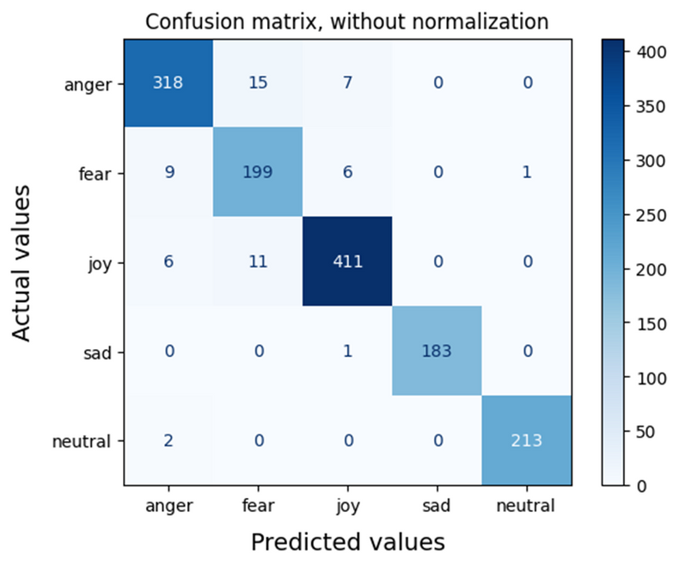
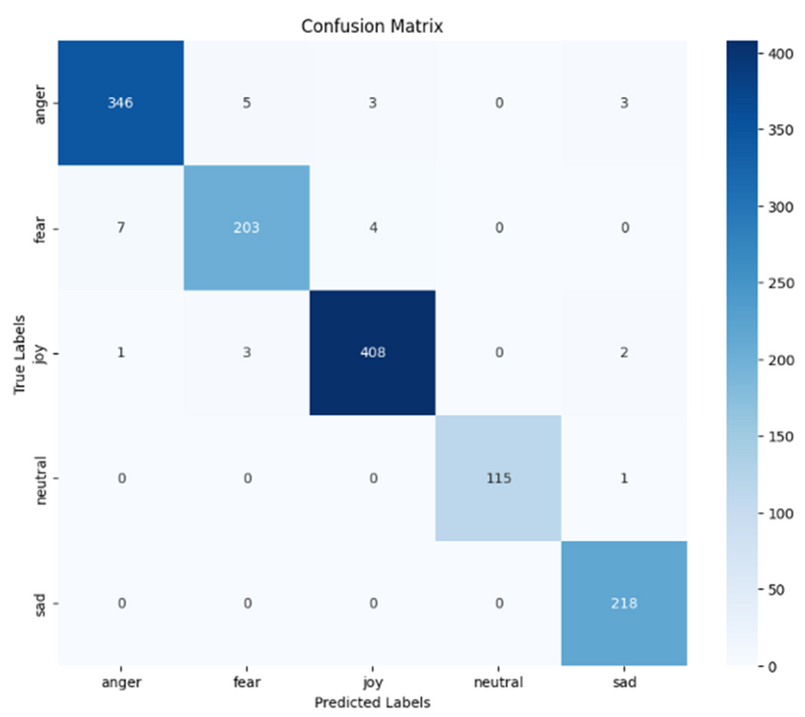
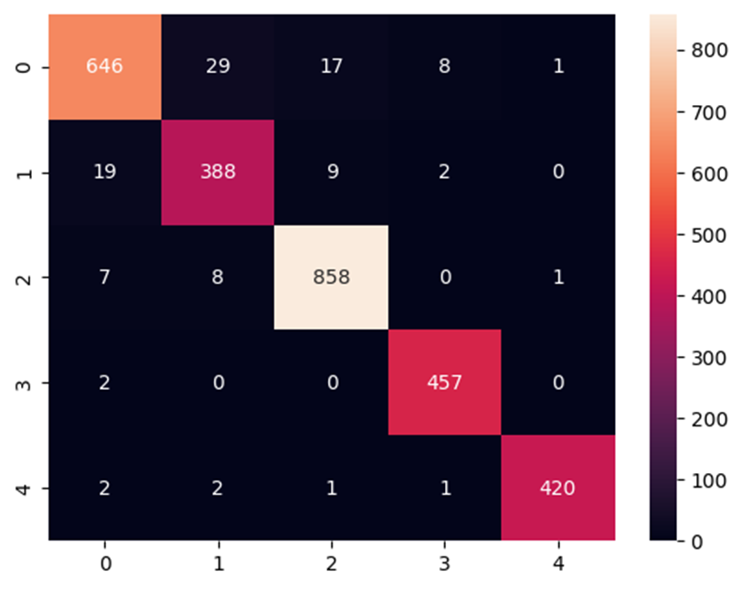
Sentiment Analysis
Confusion matrix comparison
Confusion Matrix Model 2
Confusion Matrix Model 3
Confusion Matrix Model 1

Slide 34
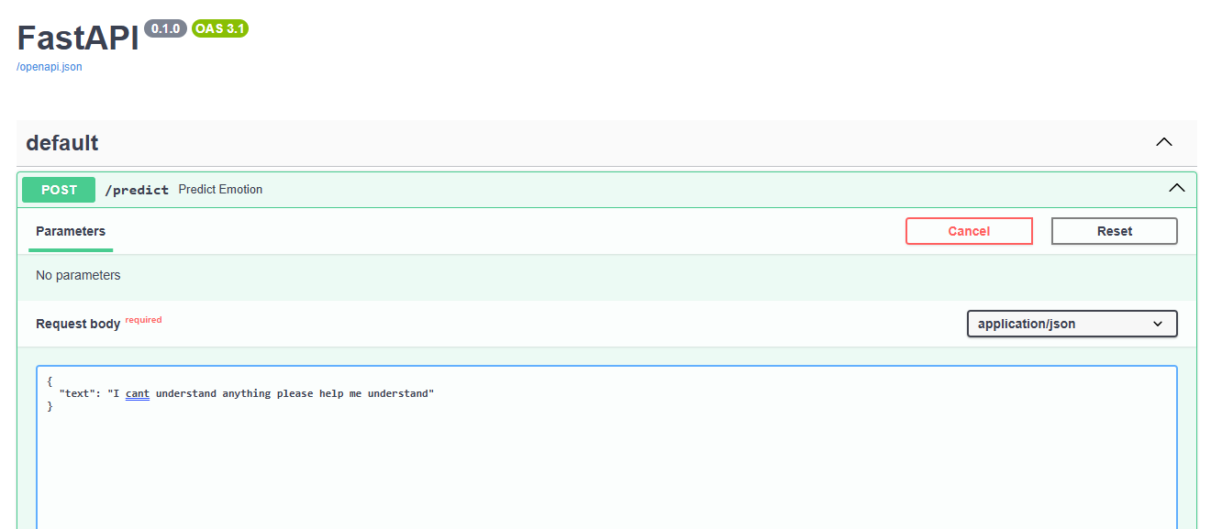
Development of Fast Api of Model to integrate with project
This FastAPI api is designed to serve a text classification model that predicts emotions from text input.
we have make display is on swagger after making the Api.

Slide 35
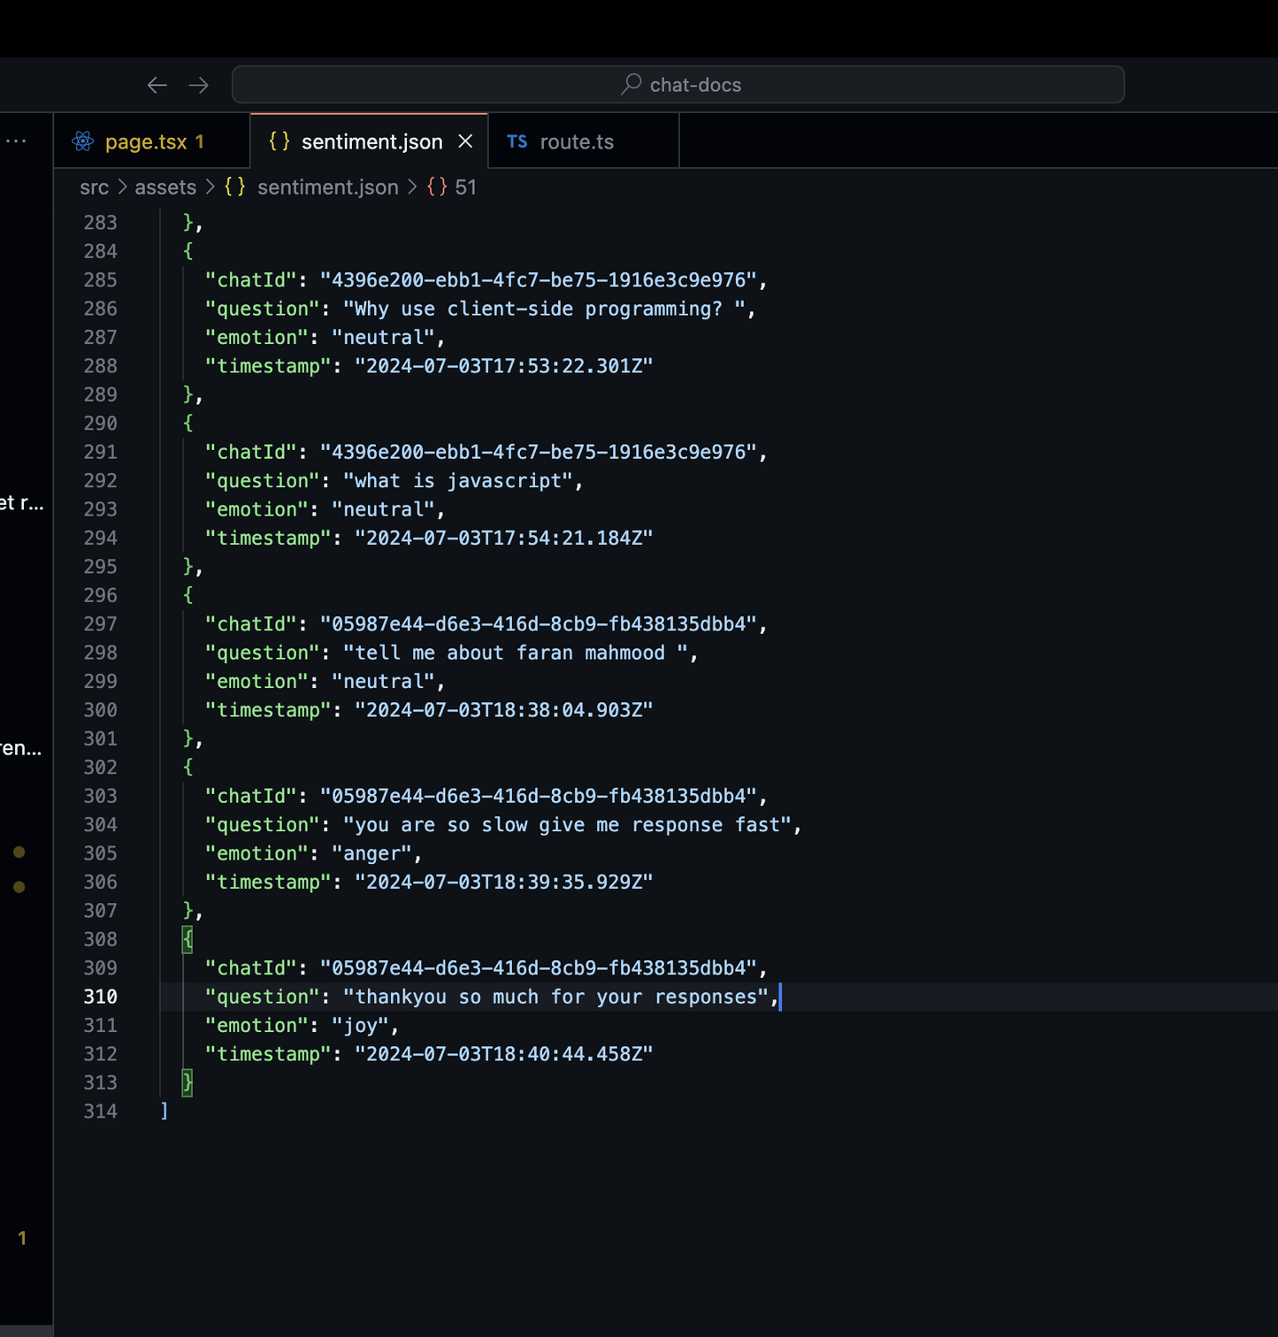
Sentiment Analysis
model Results

Slide 36
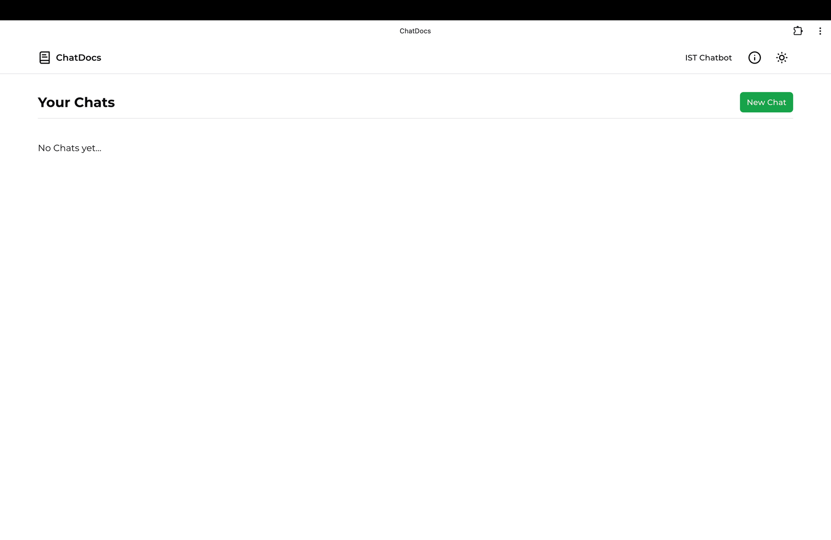
Front End Display ( Home Page)

Slide 37
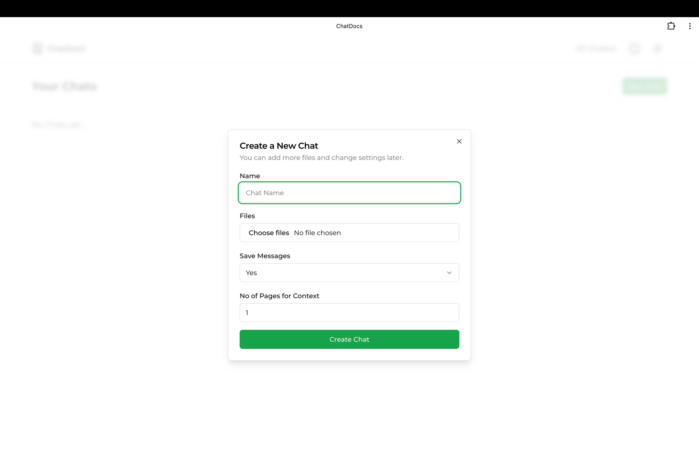
Front End Display ( New Chat Create)

Slide 38
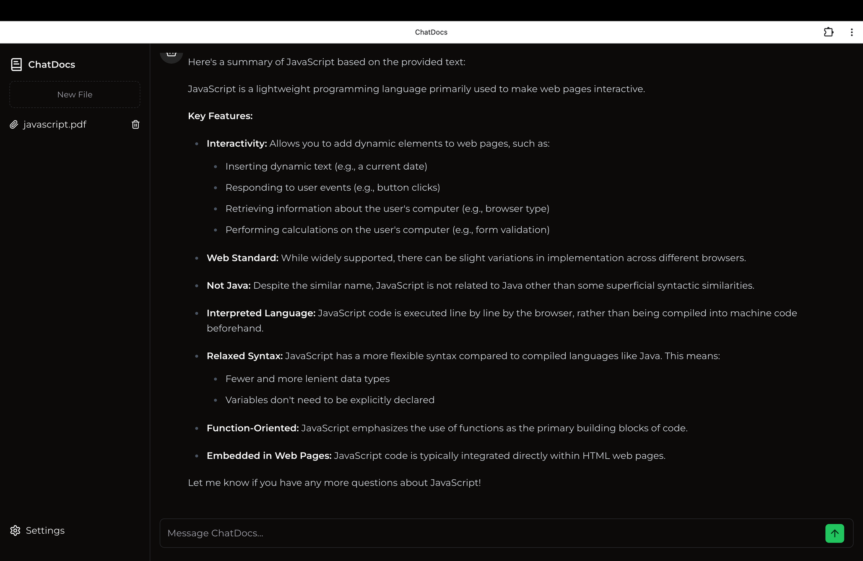
Front End Display (Chatbot)

Slide 39
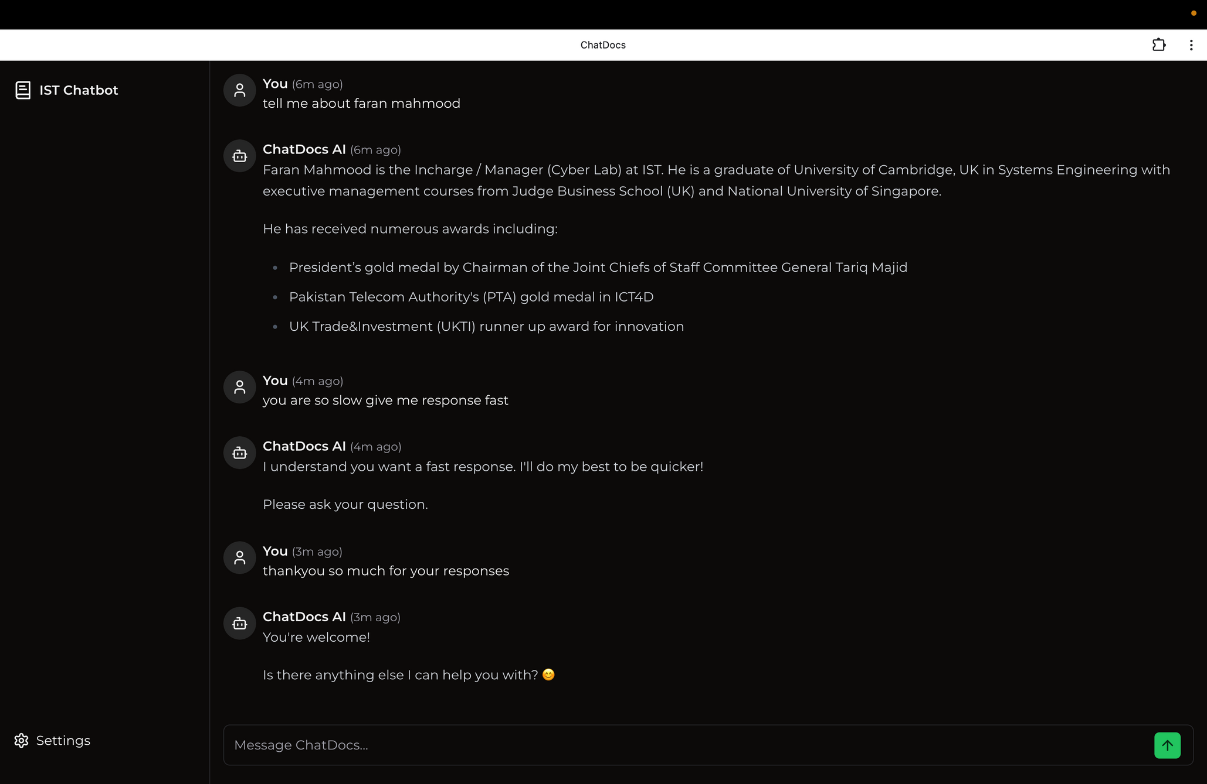
Front End Display (IST Chatbot)

Slide 40
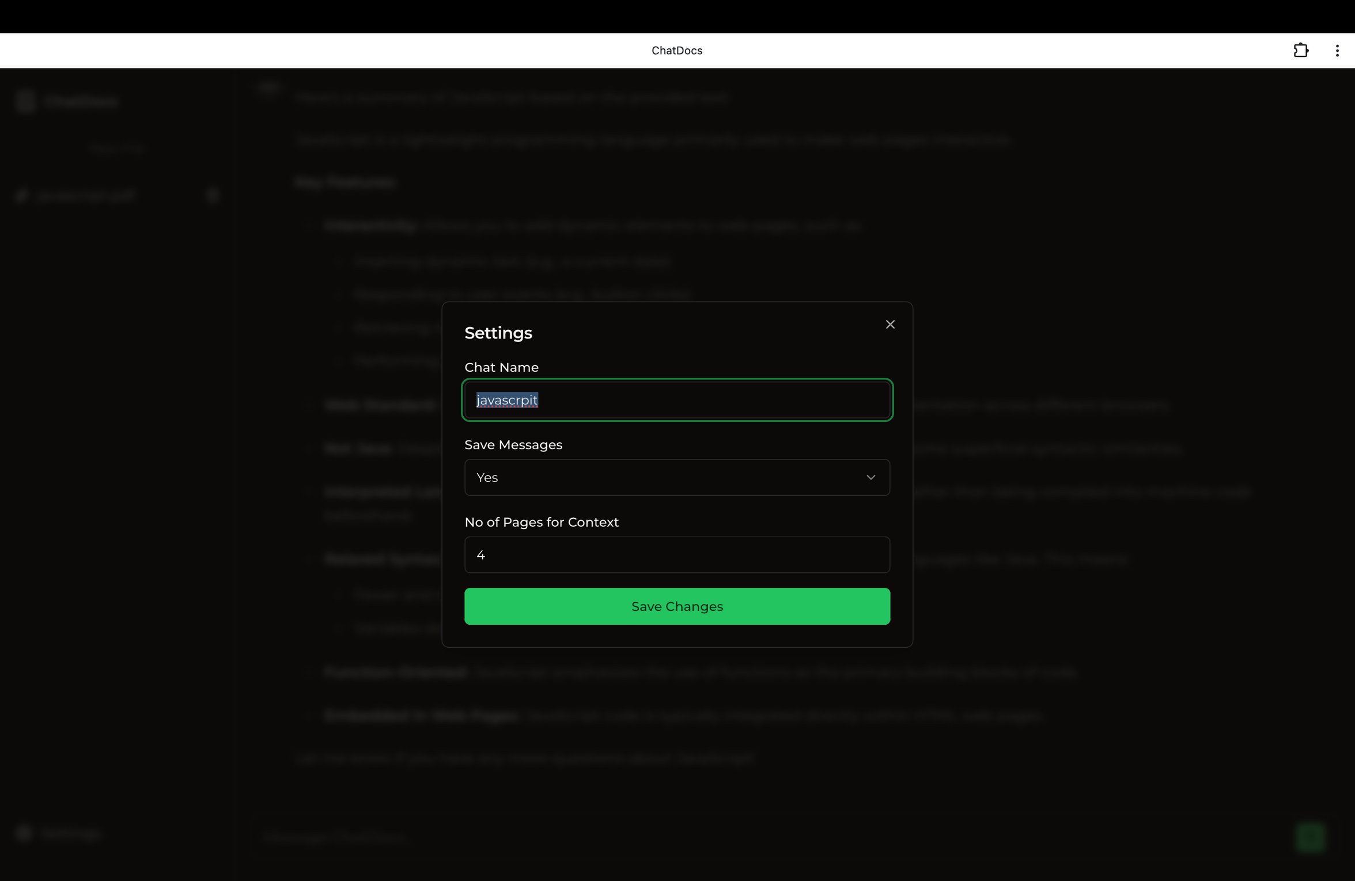
Front End (feature to save chats)

Slide 41
Database Schema Overview
Introduction to SQLite as a Lightweight, Embedded RDBMS:
SQLite is chosen for its lightweight nature and embedded capability, suitable for desktop and mobile applications.
It operates directly on the file system without a separate server process, making it easy to deploy and manage.
6

Slide 42
Database Schema Overview
Description of Key Tables:
The chats table:
Stores information about each chat session, including metadata like name and creation timestamp.
The chat Message table:
Records individual messages exchanged within each chat session, linking back to chats via foreign key.
The chat Files table:
Manages files associated with specific chat sessions, storing file names, paths, and timestamps.
The settings table:
Holds application settings that can be dynamically configured and stored for each user or session.
6

Slide 43
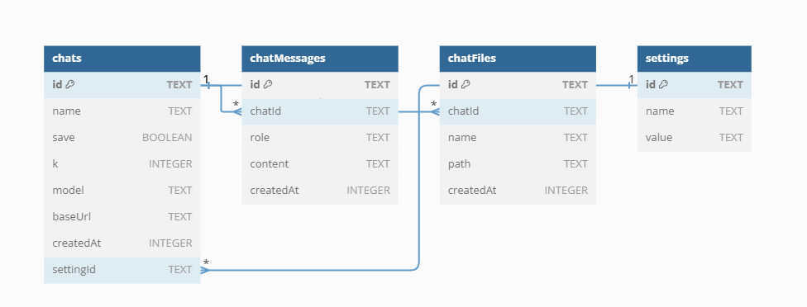
Database Schema
Entity Relationship Diagram:
6

Slide 44
Database Operations
CRUD:
Create Read Update Delete
Create:
Adding a new chat session with a unique ID and initial settings.
Read:
Retrieving all messages in a specific chat or displaying user preferences.
Update:
Modifying the content of a message or updating chat session details.
Delete:
Removing a chat session and all associated messages or deleting a file from a chat.
6

Slide 45
Web Scrapping Module
Overview of Module:
Our project is about creating a system that can analyze documents without being connected to the internet. We are using large language models to do this. To get the data we need, we're focusing on collecting information from the IST website and then analyzing it.
6

Slide 46
Web Scrapping Module
Objectives:
Develop a web scraper for IST website
Extract and clean text content from web pages
Save cleaned text for offline analysis
Provide a comprehensive view of scraping process and results
6

Slide 47
Web Scrapping Module
Importance of Web Scrapping in Data Collection:
Web scraping is a method of automatically gathering large amounts of data from websites. This is important because it helps us collect diverse data quickly and efficiently.
With web scraping, we can save time and make sure our data is always current and complete.
6

Slide 48
Web Scrapping Module
Specific Focus on Scraping IST Website for Document Analysis:
The IST website has a lot of useful information, like articles, announcements, research papers, and other documents.
Our web scraper will collect text from these documents, clean it up, save it, and then analyze it.
This will help us understand the content and structure of the documents on the IST website and improve our system for analyzing documents using language models.
6

Slide 49
Web Scrapping Module
Flow Chart:
6

Slide 50
Web Scrapping Module
Workflow Overview:
SSL Certificate Issues:
SSL (Secure Sockets Layer):
Standard security technology for establishing an encrypted link between a server and a client.
Ensures data privacy, authentication, and integrity.
Certificate Issues:
Occur when the SSL certificate is not trusted or has expired.
Can block the web scraper from accessing certain sites.
Handling in Code:
Use HttpsAgent with rejectUnauthorized: false to bypass certificate validation.
6

Slide 51
Web Scrapping Module
Workflow Overview:
Initialize HTTPS Agent:
Set up the HTTPS agent to handle secure web requests, including those with SSL certificate issues.
Ensure Directory for Saving Text Exists:
Check if the directory for saving text exists. If not, create it.
Fetch HTML Content from URLs:
Retrieve HTML content from URLs. Skip non-HTML files like PDFs or images and social media links.
Clean and Extract Relevant Text:
Remove unwanted elements like scripts and styles. Extract text from headings and paragraphs.
6

Slide 52
Web Scrapping Module
Workflow Overview:
Save Cleaned Text to Files:
Save the cleaned text into a file with a unique filename derived from the URL.
Extract New Links from Pages and Add to Queue:
Identify and extract valid links from the current page. Add new links to the queue for further processing.
Recursively Process URLs:
Continue processing each URL in the queue. Fetch, clean, save text, and extract new links until the queue is empty.
6

Slide 53
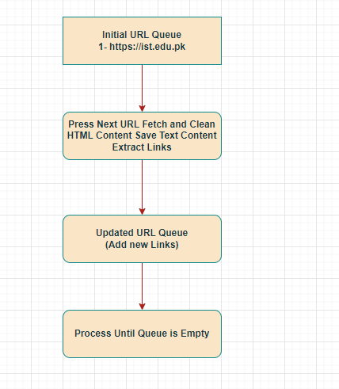
Web Scrapping Module
URL Queue Diagram:
6

Slide 54
Web Scrapping Module
Performance Metrics:
Time Taken for Scraping:
The entire web scraping process took approximately 40 minutes during testing. The time can vary based on several factors, such as the number of pages being scraped and the complexity of the web pages.
Factors Affecting Performance:
Network Speed: A faster internet connection can significantly reduce the time required for fetching web pages.
System Resources: The CPU, memory, and storage capabilities of the computer running the scraper can impact performance. More powerful hardware can process data faster.
Website Response Time: The speed at which the target website responds to requests also affects the overall scraping time.
6

Slide 55
Web Scrapping Module
Challenges And Solutions:
Handling Non-HTML Content and Irrelevant Links:
Challenge: The scraper encounters non-HTML files , PDFs, images and irrelevant links (e.g., social media).
Solution: Implemented filters to skip non-HTML files and social media links, focusing only on relevant HTML content.
6

Slide 56
Web Scrapping Module
Challenges And Solutions:
Managing Large Volumes of Data:
Challenge: Processing and storing large amounts of data can be resource-intensive.
Solution: Efficient data management by ensuring directories exist for storage, and using optimized file handling techniques to save cleaned text.
6

Slide 57
Web Scrapping Module
Challenges And Solutions:
Ensuring Accurate Text Extraction:
Challenge: Extracting meaningful text while removing unwanted elements like scripts and styles.
Solution: Utilized Cheerio library to clean HTML content, removing unwanted elements and accurately extracting text from headings and paragraphs.
6

Slide 58
Developing a Desktop Application with React PWA Technology
Technologies Used and Integration Process:
Progressive Web App (PWA):
Offline Access: Your app can work even without an internet connection by storing data locally.
Installability: Users can add your app to their home screen or desktop, just like a regular app.
Enhanced Performance: It loads quickly and can send push notifications to keep users engaged.
Cross-platform Compatibility: You can write your code once and run it on iOS, Android, and desktop, saving time and effort.
Strong Community: There are lots of libraries and tools available, and many developers use it, so help is easy to find.
6

Slide 59
Developing a Desktop Application with React PWA Technology
Technologies Used and Integration Process:
Integration Process:
Project Setup: Started the project with Create React App (CRA) to create a new project in PWA environment.
PWA Configuration: Define the app metadata that include icons , name and theme color in the manifest file .Set up tools like Webpack, service workers for offline functionality.
Components Development: Built reusable components that work on different devices and made sure the design looks good on all screens.
Manifest File and Service Worker Implementation: Manifest file informs the browser about how the app should be presented to user and service worker integration manages catching , handle offline functionality and enable push notification.
.
6

Slide 60
Developing a Desktop Application with React PWA Technology
Conclusion:
Achievements:
High-Quality User Experience: Created an app that is easy and pleasant to use on any device.
Cross-Platform Functionality: The app works well on both web and desktop.
Modern Development Practices: Used the latest technologies like React PWA to build a strong, reliable app.
6

Slide 61
Future Work
Enhancements: Plan to add more features to improve the app.
Optimization: Will keep working on making the app faster and more efficient.
Accuracy: More work on this to improve accuracy of responses
6

Slide 62
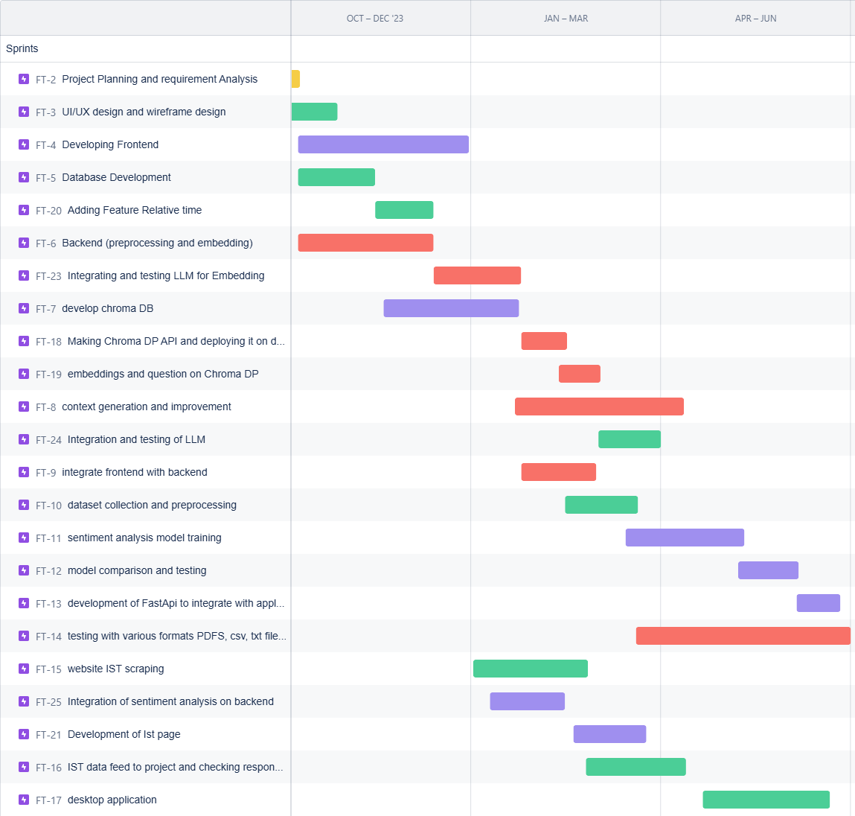
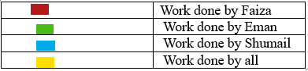
Gantt char

Slide 63
Thank you
for listening

